Slide 1


2016 Executive Summary

Slide 2
Subscriber Profile
33,685
Reach Business Owners and
Senior-Level Executives:
E-mail Newsletter
Published 5x/week
Subscribers
as of May 11, 2015
All subscribers are ASME members who opt in.
Reach senior-level managers and engineering teams in high-profile companies such as:
Baker Hughes
Bechtel
Boeing
BP Global
Chevron
Duke Energy
Dupont
Exxonmobil
Fluor
General Electric
General Motors
Halliburton
Honeywell
IBM
Ingersoll Rand
Lockheed Martin
NASA
National Grid
Northrop Grumman
Pratt & Whitney
Raythen
Schlumberger
Sandia National Labs
Westinghouse Electric
Target Large Engineering Companies:

Slide 3

Sample Email Newsletter
What is ASME SmartBrief?
An opt-in, e-mail newsletter, read by highly-engaged engineers/managers interested in news pertaining to entrepreneurship.
Comprised of the day’s top news about and for entrepreneurs, sourced from hundreds of top media outlets and trade publications.
Praise for ASME SmartBrief:
“It’s about more than just awareness building.
It has had a definite impact on how I do business. The information is so timely and
far-reaching that it helps me to think about innovation and development going forward.”
– CEO
“When I meet with clients, I am better-informed. I know things [they] haven’t heard yet, and it allows me to speak knowledgeably about a wide range of topics. It is a great confidence-builder.”
– President & CEO

Slide 4
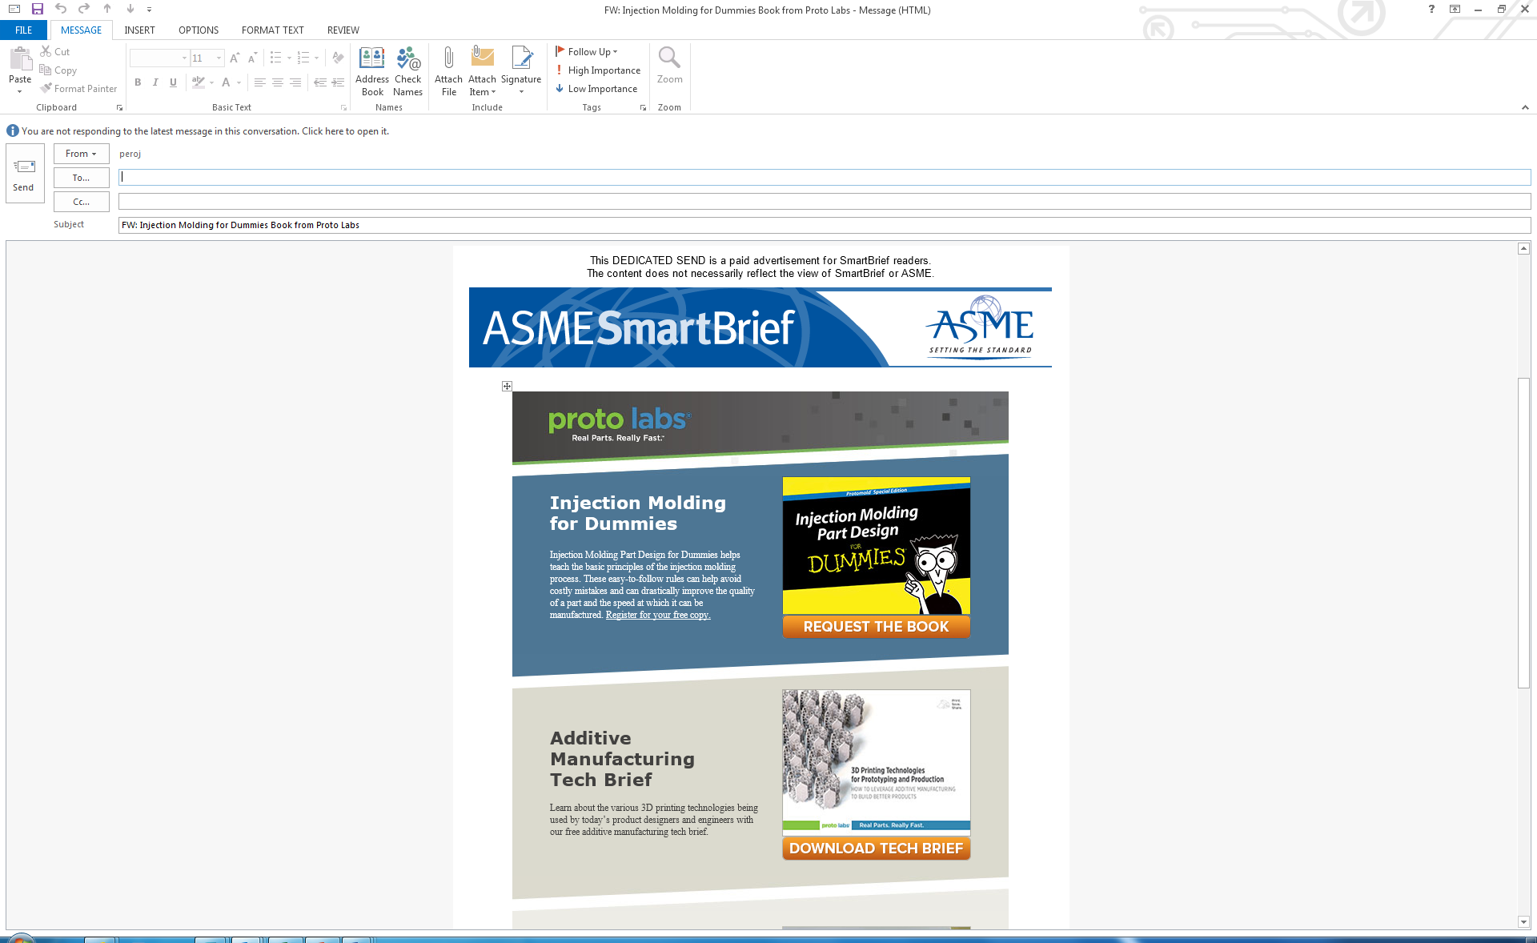
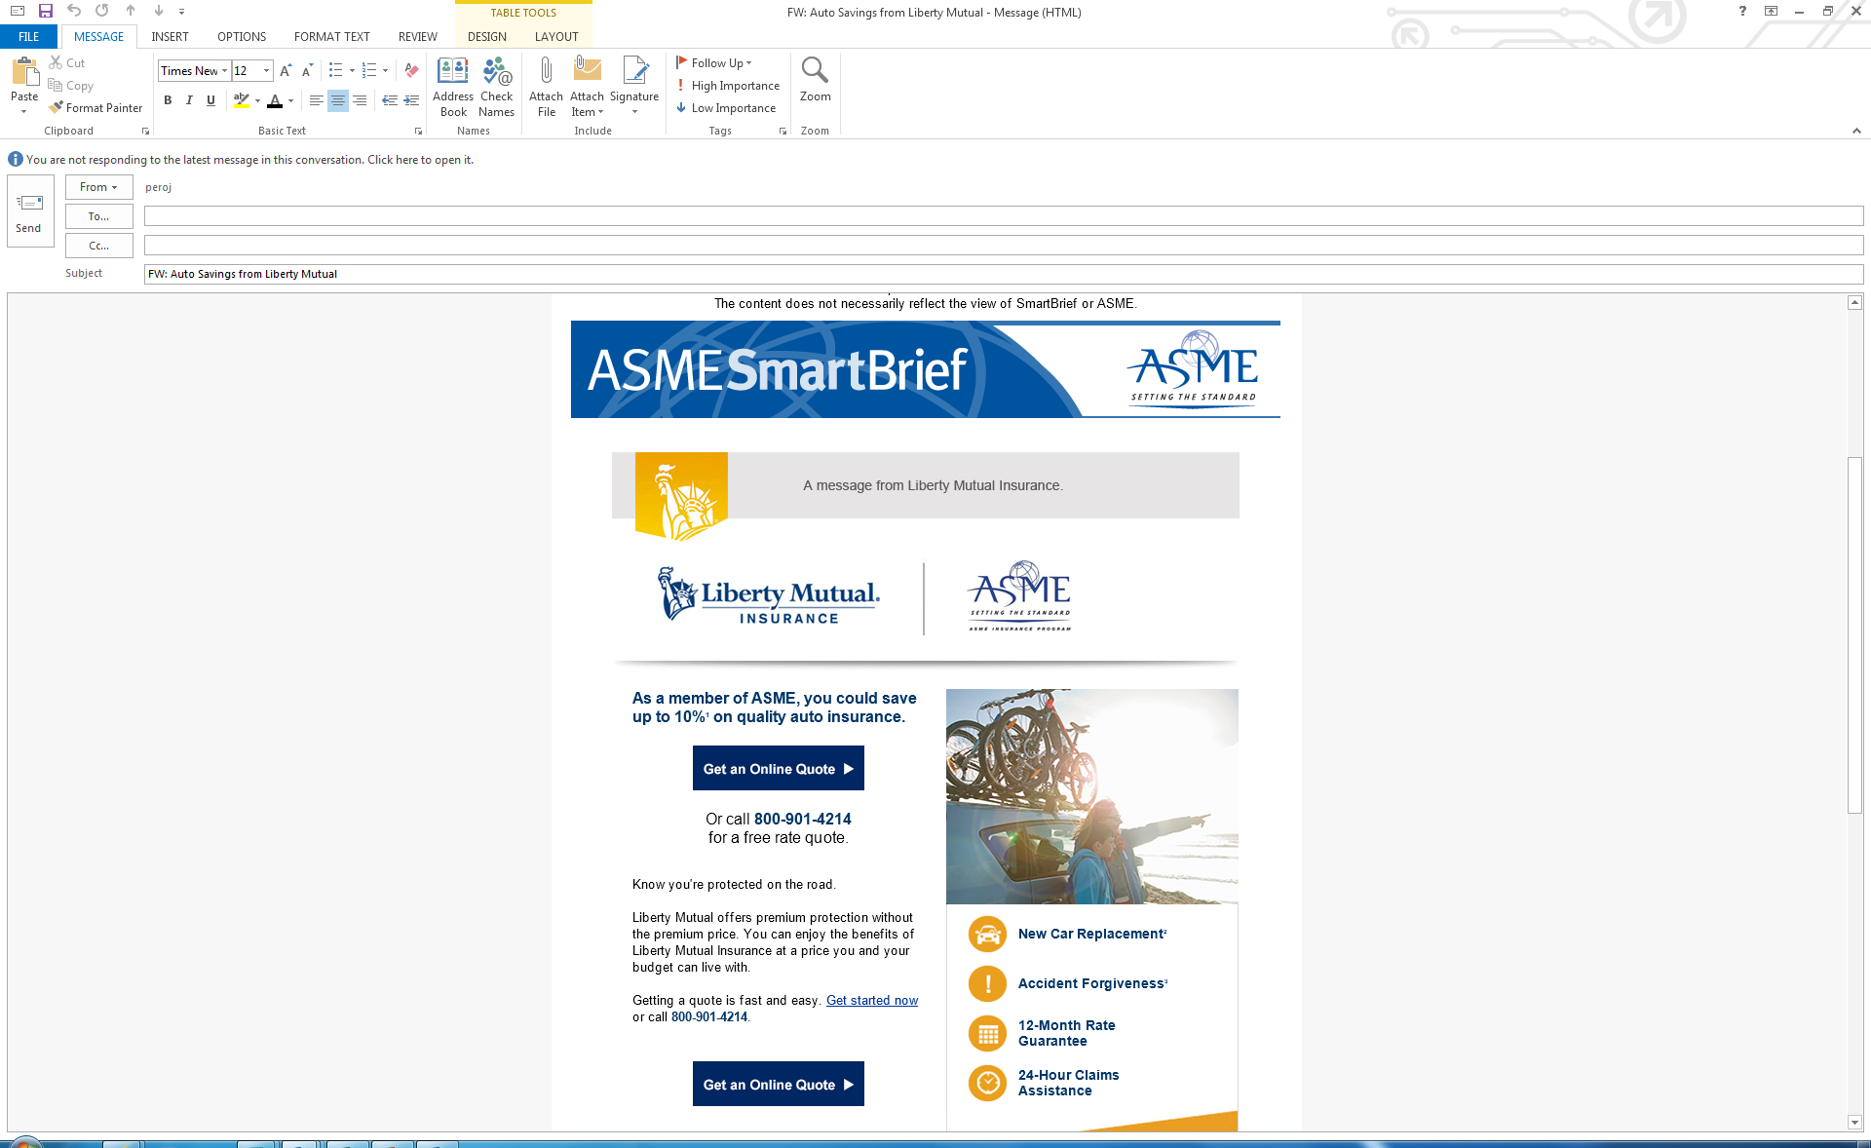
Sample Dedicated Send Email
Sponsors can leverage the ASME SmartBrief e-newsletter platform to send a timely, tailored message to the entire 34,000+ subscriber base – all of whom have opted in to receive third-party communications sent on behalf of a vendor.
The average open rate (40%+) and click thru rates (4%+) are significantly higher than industry standards.
SmartBrief dedicated sends can be published once per week. Reservations are accepted on a ‘first come, first served’ basis.
The “Dedicated Send” sponsorship gives you the unique opportunity to send an exclusive, 100% ad-content e-mail which can be used for lead generation, important announcements or branding. It can also be used to leverage more of your organization’s content and insight with an “advertorial” flavor.

Slide 5
Engineers Respond to ASME SmartBrief
“I am the Webmaster Administrator, and hardly a day goes by that I do not find an article in your newsletter that I share on our Facebook page. Thanks for providing such interesting, diverse articles.”
“I really like this SmartBrief update and news bulletin. I look forward to these updates every day.”
“I am glad to subscribe to your valuable news pack, which is going to help me lot in future.”
“Great publications, many thanks.”
“I look forward to reading ASME SmartBrief daily. It is the best and only engineering daily newsletter that I subscribe to!”
“SmartBrief is a GREAT idea. I love it. I'm sending it to all my colleagues, interested engineers.”
“These SmartBriefs are a great idea! Please keep them coming. I like the concept and format.”
“Just started SmartBrief and they are Great!!! Kudos to all at ASME for bringing this service to the Membership!”
“I’ve really been enjoying the new SmartBrief email I receive in my inbox. The links have been very relevant to my field and an interesting way to take a break from my regular work.”
“The newsletter is great. This is one of the best ideas that ASME has come up with. The content is very interesting. Keep them coming!”
“I greatly appreciate this service. In a commercial environment that focuses on immediacy and efficiency, it is helpful to have a source of technology news that emphasizes succinctness without compromising value.”
“Thank you for this wonderful channel of information.”

Slide 6
Company Type
Company Type Subscribers
Energy 3,959
Manufacturing 3,516
Consulting 3,359
Higher Education 3,452
Aerospace & Aviation 1,706
Government 1,127
Construction 968
Utilities 808
Automotive 825
Professional Services 751
Industrial Supplies & Equipment 680
Healthcare & Biotechnology 505
Computer & Electronics/IT 348
Chemicals 447
Transportation 177
Food/Beverages 145

Slide 7
Position/Function
Engineering Sales
Research & Development Marketing
Professor/academic Customer Service
Consultant IT
Project Management Legal
Executive Management Accouting/finance
Operations Hr
Staff Architecture
Technician Regulatory

Slide 8
Title
Owner/Principal 1,749
Chairman/CEO 453
President 752
VP/ Executive VP/ Senior VP 669
Other corporate level 147
Director 1,374
Supervisor 1,097
Manager 3,538
Professional 9,065
Staff 2,612

Slide 9
Highly Engaged and Responsive
We continue recruiting new subscribers from our growing member base.
Average Open Rate: 30.0%
Clickthrough Rate: 7.6%
Issue Date | Total Sent | Unique Opens | Clicks
Mar. 4, 2015 | 33,733 | 10,483 | 3,091
Mar. 5, 2015 | 33,736 | 10,043 | 1,949
Mar. 6, 2015 | 33,727 | 10,202 | 3,294
Mar. 7, 2015 | 33,721 | 10,050 | 2,481
Mar. 8, 2015 | 33,712 | 9,784 | 1,966
Week’s Totals | 168,629 | 50,562 | 12,781

Slide 10

Data-Driven
Reporting
It pays to be data-driven.
Is your ad reaching the right audience? Are you getting the ROI you hoped for?
With a SmartBrief campaign, you’ll never have to wonder.
Our best-in-class reporting tools provide all the data you need for greater certainty and smarter decisions:
Reach
Impressions
Total clicks
Click-through rates
Best of all, we go beyond the aggregate data to show you exactly who’s interacting with your ad – right down to company name and job title. No more mystery. No more hunches. No more extrapolation.
Nowhere else will you find this level of detailed reporting. It’s what makes SmartBrief your advertising partner…and not just another advertising platform.

Slide 11
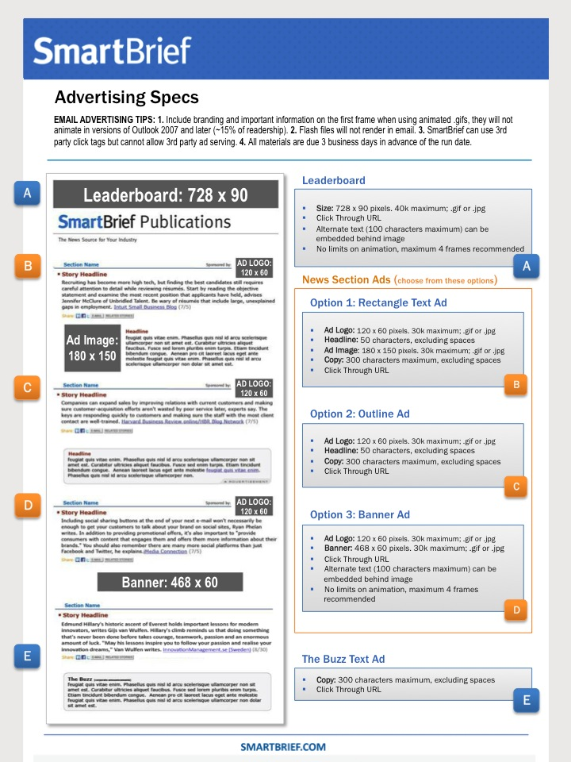
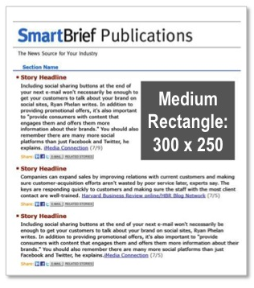
Premium
Ad Unit Sizes
Leaderboard $1,000/issue
A
A
Size: 728 x 90 pixels. 40k maximum; .gif or .jpg
Click Through URL
Alternate text (100 characters maximum) can be embedded behind image
No limits on animation, maximum 4 frames recommended
Premium Size Rectangle Ad $1,000/issue
B
Size: 300 x 250 pixels. 30k maximum; .gif or .jpg
Click Through URL
No limits on animation, maximum 4 frames recommended
Premium Unit: One per brief per day
B
The Premium Size Rectangle Ad (B) is available for any position in the News Section.

Slide 12
Standard
Ad Unit Sizes
News Section Ads
$400 to $1,000/issue, based on position
Choose from these three options:
C
Option 1: Rectangle Text Ad
Ad Logo: 120 x 60 pixels. 30k maximum; .gif or .jpg
Headline: 50 characters, excluding spaces
Ad Image: 180 x 150 pixels. 30k maximum; .gif or .jpg
Copy: 300 characters maximum, excluding spaces
Click Through URL
C
D
Option 2: Outline Ad
Ad Logo: 120 x 60 pixels. 30k maximum; .gif or .jpg
Headline: 50 characters, excluding spaces
Copy: 300 characters maximum, excluding spaces
Click Through URL
D
E
Option 3: Banner Ad
Ad Logo: 120 x 60 pixels. 30k maximum; .gif or .jpg
Banner: 468 x 60 pixels. 30k maximum; .gif or .jpg
Click Through URL
Alternate text (100 characters maximum) can be embedded behind image
No limits on animation, maximum 4 frames recommended
E
“The Buzz” Text Ad $200/issue
F
F
Copy: 300 characters maximum, excluding spaces
Click Through URL

Slide 13
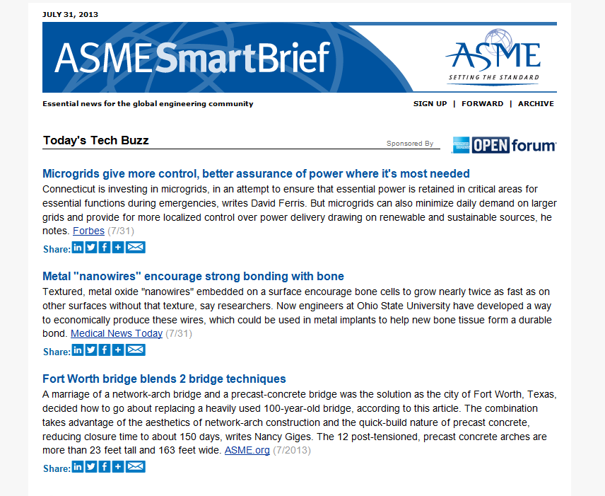
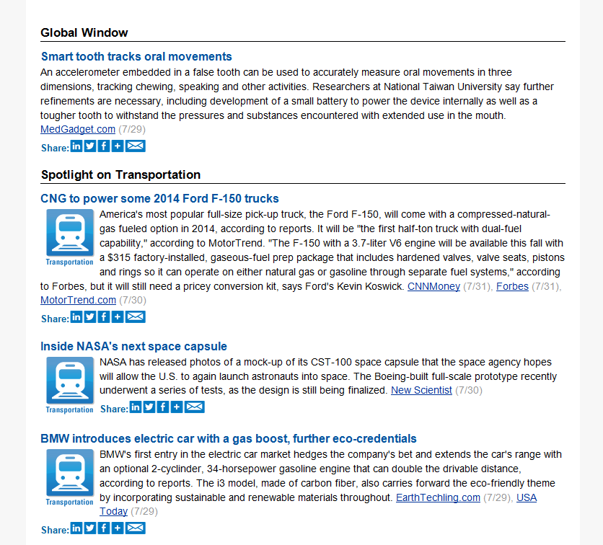
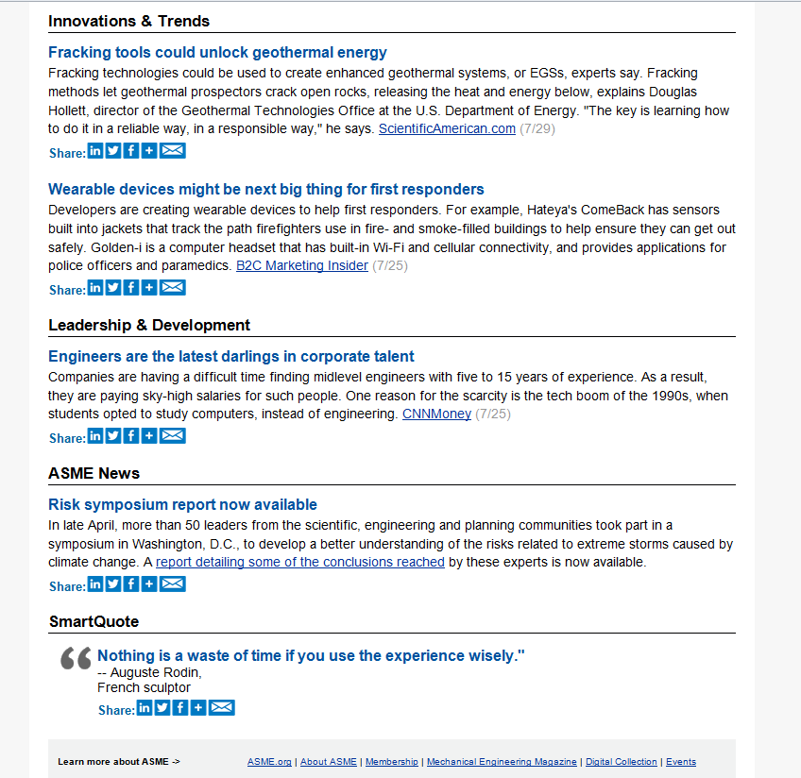
Positioning
News Section
“Today’s Tech Buzz” $1,000/issue
“Global Window” $800/issue
Exclusive Opportunities
Mondays | “Spotlight on Energy” | $800/issue
Wednesdays | “Spotlight on Transportation” | $800/issue
Fridays | “Spotlight on Biotechnology” | $800/issue
“Innovation & Trends” $600/issue
“Leadership & Development” $600/issue
“SmartQuote” $400/issue

Slide 14
Conference
Specials
NEW ALERT DAILY
News and information about
major ASME conferences.
For more information,
speak with your sales representative or
Greg Valero, Manager, Integrated Media Sales,
at 212-591-8356; valerog@asme.org

Slide 15
Advertising
Specs
EMAIL ADVERTISING TIPS
Include branding and important information on the first frame when using animated .gifs; they will not animate in versions of Outlook 2007 and later (~15% of readership).
Flash files will not render in email.
SmartBrief can use 3rd party click tags but cannot allow 3rd party ad serving.
All materials are due 5 business days prior to the ad run date.
Send ad material to James Pero at peroj@asme.org

