Slide 1

Standards and Certification Training
Module B – Process
B11. Standards Inquiries, Interpretations and Cases

Slide 2
Updates
9/13/2024 Updated to align to Rev. 19 of Operating Procedures for ASME Codes and Standards Development Committees
12/7/2015 Revised slides 3-7, 9 and 16. Added Slides 8, 14 and 17-19
3/14/2014 First Edition

Slide 3
Module B Course Outline
B1. ASME Organizational Structure
B2. Standards Development: Staff and Volunteer Roles and Responsibilities
B3. Conformity Assessment: Staff and Volunteer Roles and Responsibilities
B4. Initiating and Terminating Standards Projects
B5. Consensus Process for Standards Development
B5a. Project Management
B6. The Basics of Parliamentary Procedure
B7. The Appeals Process
B8. International Standards Development
B9. ASME Conformity Assessment Programs
B10. Performance Based Standards
B11. Standards Inquiries, Interpretations and Cases
Notes:
Module B contains eleven modules. We will cover B11 – Standards Inquiries, Interpretations and Cases.

Slide 4
LEARNING OBJECTIVES
At the end of this module you will be able to understand:
  What is an Interpretation
  How to submit an inquiry or request for Interpretation online
  The approval process for an Interpretation
  How to search for approved Interpretations online
  What a case is and why they are used
  The approval process for a Case
Notes:
At the end of this module you will know…
What is an Interpretation
How to submit an inquiry or a Request for Interpretation
The approval process for an Interpretation
How to search for approved Interpretations online
What is a Case
The approval process for a Case

Slide 5
COMMITTEE RESPONSE
TO AN INQUIRY
Inquiries can be submitted by anyone.
The avenues in which a Committee may address an inquiry:
  Informal Responses
  Requests for Revision
  Interpretations
  Cases
Notes:
Inquiries can be submitted by anyone. This could include members of the public, users of the standards, purchasers of ASME stamped products, other ASME S&C committees, certificate holders, etc.
Due to the impact ASME Codes and Standards have on various industries, there are a few avenues in which a Committee may address an inquiry:
Informal responses can be given by Staff Secretaries or volunteers. Informal responses could include referencing the inquirer to previous interpretations or other sections of the standard. The responses may be either verbal or in writing and should include a clear statement by the staff person or volunteer that he or she is expressing his or her opinion and not an interpretation. Informal responses are not given on ASME Interpretation letterhead.
Requests for revision to a standard, such as proposed technical changes, editorial changes or errata, are forwarded to the appropriate committee for consideration. These are addressed directly to the staff.
Interpretations are a formal response to a written inquiry and the response is prepared on official ASME interpretation letterhead.
Cases are used to provide alternatives to existing requirements, or to allow early and urgent implementation of a revised requirement.
For the rest of this module we will focus on Interpretations and Cases.

Slide 6
INTERPRETATION REQUESTS TO ASME DEVELOPMENT COMMITTEES
How to Submit a Request for Interpretation:
  Online using the Inquiry Submittal Form at…
  http://cstools.asme.org/Interpretation/InterpretationForm.cfm
NOTE: ASME approval process was strengthened as a result)
Notes:
Interpretations should be submitted using the Interpretation Inqiury Submittal Form online.
The submittal form can be accessed online at: www.ASME.org > About ASME > Get Involved >Standards & Certification Development Committees > Contact Committees or through the link shown here.
Note: ASME does not approve, certify, rate or endorse any item, construction, proprietary device or activity nor does staff provide consulting advice.

Slide 7
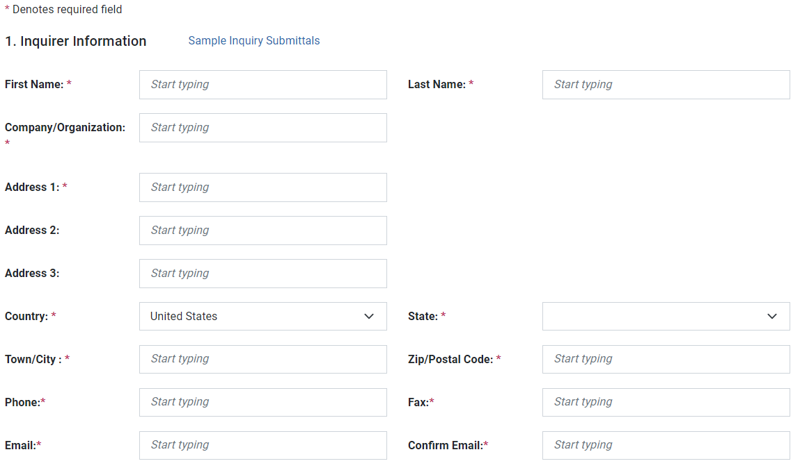
INTERPRETATION SUBMITTAL FORM 1/3
Notes:
Here is the Interpretations Submittal Form.
As noted here, the inquirer’s name and address are required.
Standards designations must be selected by highlighting the standard designation so that the inquiry is directed to the correct staff secretary .
Note: if your question(s) applies (y) to more that one standard, select the most appropriate standard and reference any others in your inquiry.

Slide 8
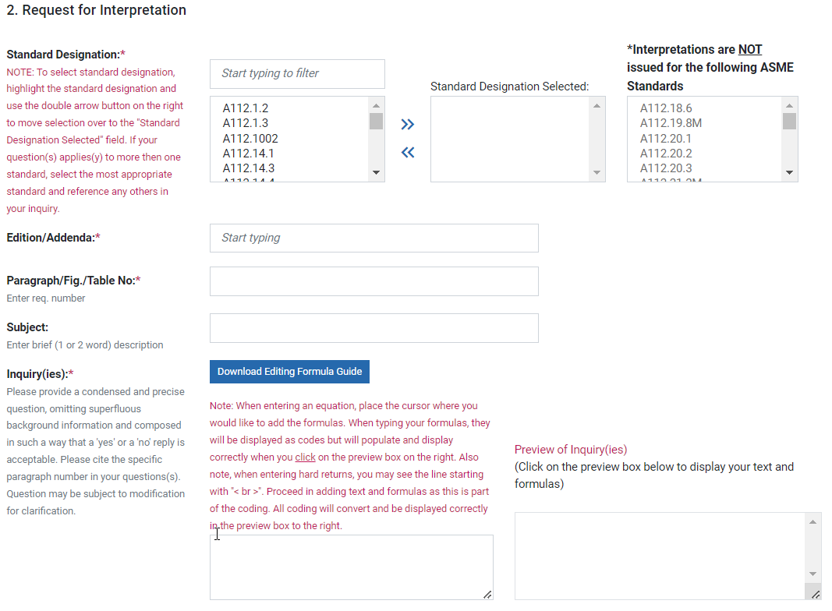
INTERPRETATION SUBMITTAL FORM 2/3
Notes:
The second part of the Interpretation Submittal Form is where the inquiry, proposed reply, background and applicable editions are provided. The submitter should be as specific as possible.
For the inquiry, the interpretation submittal form gives guidance on how to submit your inquiry. The question should be submitted in such a way that a 'yes' or a 'no' reply is acceptable. The specific standard number, publication year, addenda (if applicable) and paragraph number must be submitted with your questions(s).
The proposed reply should be in the form of a Yes or No answer with explanation as needed. If entering replies to more than one question, please be sure to number your questions and replies.
Background information can be added that will assist the committee in understanding the inquiry and an attachment can be added.

Slide 9
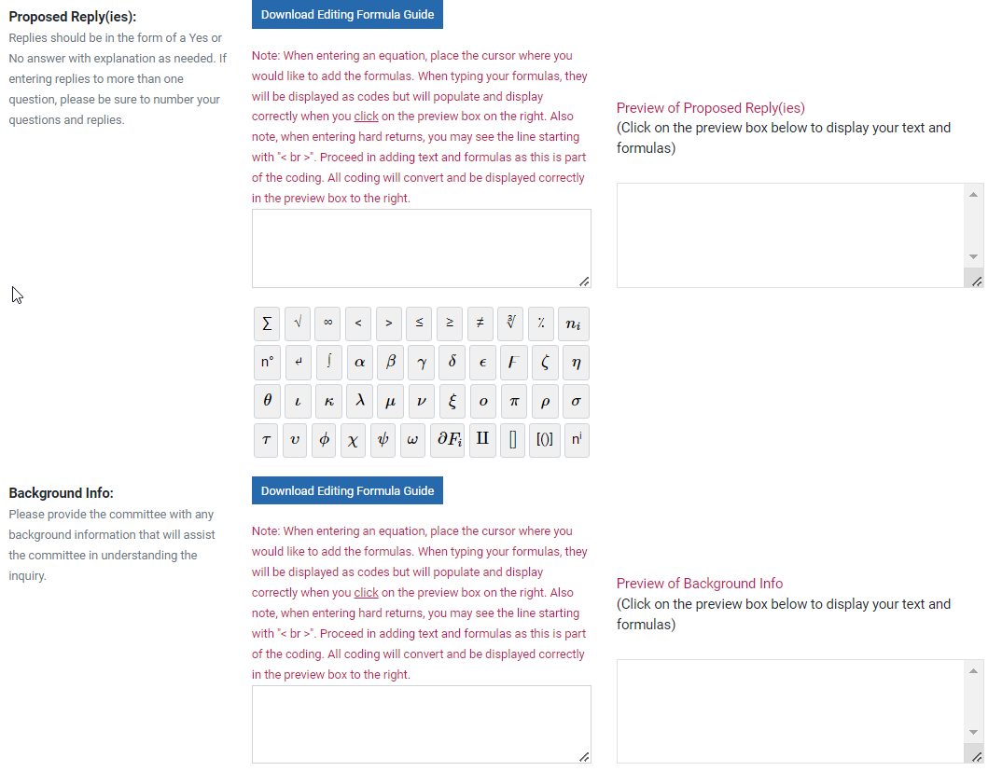
INTERPRETATION SUBMITTAL FORM 2/3

Slide 10
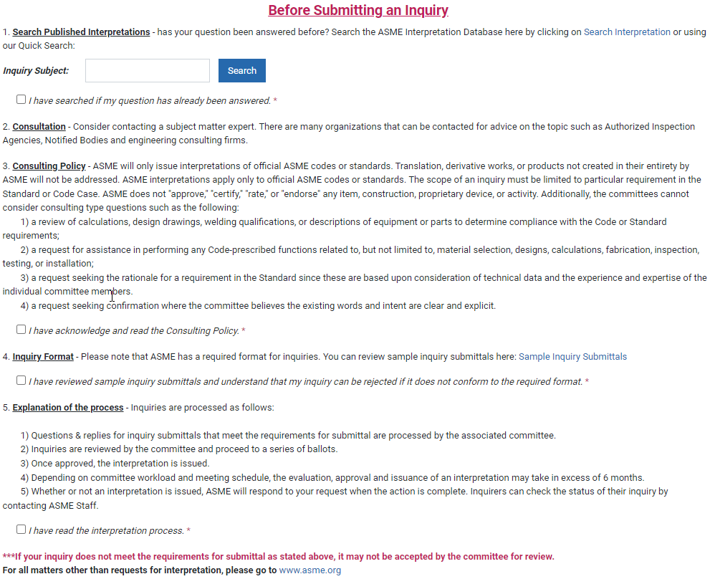
INTERPRETATION SUBMITTAL FORM 3/3
Notes:
The third part of the Interpretation Submittal Form is where guidance is given to the inquirer.
This section notifies the inquirer that requests for interpretation must be limited to an interpretation of a particular requirement in the Standard or Code Case.
ASME does not "approve," "certify," "rate," or "endorse" any item, construction, proprietary device, or activity.
The committees will not consider consulting type questions such as the following:
1) a review of calculations, design drawings, or descriptions of equipment or parts to determine compliance with the
requirements in the Standard;
2) a request for assistance in performing any Code-prescribed functions related to, but not limited to, material
selection, designs, calculations, fabrication, inspection, testing, or installation;
3) a request seeking the rationale for a requirement in the Standard since these are based upon consideration of
technical data and the experience and expertise of the individual committee members.
If the inquiry does not meet the requirements for submittal, it may not be accepted by the committee for review.
Once the inquirer submits the Interpretation Submittal Form, an auto-notification will provide the tracking number to the inquirer for future reference. An additional auto-notification also informs the Staff Secretary of the submittal.

Slide 11
INTERPRETATIONS SUBMITTED TO ASME DEVELOPMENT COMMITTEES
Staff Secretary reviews the inquiry request.
Staff Secretary may contact inquirer if additional information is needed or the question needs to be reformatted.
Staff Secretary notifies the standards committee officers of the inquiry, if it requires further standards committee action.
The Chair assigns the inquiry to a group or the whole committee for further review.
Notes:
After the Staff Secretary receives the inquiry, the Staff Secretary reviews the inquiry request to determine if it is
A valid Interpretation (we will cover examples of inappropriate requests)
The question is already covered in the standard
The question has been previously answered or
The interpretation or case is in the correct format.
The Secretary may contact the inquirer if there are any questions and will notify the standards committee Officers of the inquiry, if further standards committee action is required.
Staff Secretary then notifies the standards committee officers of the inquiry, if it requires further standards committee action.
The standards committee Chair assigns the inquiry to a group or the whole committee for further review.

Slide 12
TYPES OF INTERPRETATIONS
1) Interpretation
  Clarifies existing requirements where there is ambiguous wording in the standard.
2) Intent Interpretation
  To resolve conflicting or incorrect wording in the standard.
  Revision to the standard supporting the interpretation approved before the interpretation may be issued.
  Shall not revise existing requirements or establish new requirements
Notes:
There are 2 types of interpretations:
An interpretation clarifies existing code requirements where there is ambiguous wording in the standard.
An Intent Interpretation is to resolve conflicting wording in the code and results in a revision to standard. The standard revision is approved by the Consensus Committee before the interpretation response letter may be issued. Intent interpretations shall not revise existing requirements or establish new requirements.
Note: Not all Committees respond to interpretation requests. Committees that do will state it in their Operating Guide Annex Z. The C&S Connect Interpretation Submittal Form identifies which standards do not issue interpretations.

Slide 13
INTERPRETATION APPROVAL
Approval Options:
  Consensus Committee
  Cognizant Subcommittee
  A Special Committee
Balance Requirement
Notes:
Interpretations are approved in accordance with ANSI Accredited Procedures and committee Operating Guide Annex Z. Depending on the committee, they could be approved by:
Consensus Committee
Cognizant Subcommittee
OR
A Special Committee
No member interest category shall have a majority on any Consensus Committee, Cognizant Subcommittee or Special Committee approving an Interpretation.
Board and ANSI approval is not needed for interpretations, except for changes to the standard that would be included as part of an intent interpretation.

Slide 14
INTERPRETATION APPROVAL PROCESS
CONSENSUS COMMITTEE or SUBCOMMITTEE
  Vote Options:
    Objection, No Objection, Not Voting
Meeting Vote
  No objection by two thirds of those present needed for approval, if quorum is present provided greater than 50% of the total consensus body has voted no objection.
Ballot Vote
  First Consideration Ballot - no objections, no additional revisions. No objection by 2/3 of the voting members, provided greater than 50% of the total consensus body has voted no objection
  Recirculation Ballot – no objection by 2/3 of the voting members, provided greater than 50% of the total consensus body has voted no objection.
Notes:
Voters are given three voting options: No Objection, Objection, Not Voting. An objection must provide written justification and alternative action that will resolve their objection.
Vote taken at a meeting requires no objection by at least 2/3 of those present and eligible to vote for the interpretation to pass, if a quorum is present, provided greater than 50% of the total consensus body has voted no objection.
For ballot vote, the proposal passes on first consideration when there are no objections and no additional revisions, where no objection by at least two thirds of members voting is required to approve the interpretation provided greater than 50% of the total consensus body has voted no objection.
If not, a recirculation ballot will be issued, where no objection by at least two thirds of members voting is required to approve the interpretation provided greater than 50% of the total consensus body has voted no objection.

Slide 15
INTERPRETATION APPROVAL PROCESS
SPECIAL COMMITTEE
Minimum 5 members, including Staff Secretary
Must be members of the Consensus Committee and/or a subordinate group, with no member interest category having a majority.
Appointed by Chair of Standards Committee or Cognizant Subcommittee
Voting Options: Objection, No Objection, and Not Voting.
All members including Staff Secretary must vote no objection for interpretation to be approved.
Unresolvable objections should be referred to the consensus committee or Cognizant Subcommittee.
Notes:
Another option for approving interpretations is by a Special Committee.
Special Committees must have at least five members, one of which shall be the Staff Secretary responsible for the standard.
It’s membership must be from the consensus committee or a subordinate group, with no member interest category having a majority on the special committee.
Special Committee members shall be appointed by the Chair of the Standards Committee or cognizant subcommittee.
No member interest category can have a majority on the Special Committee.
Voters are only provided 3 voting options: Objection, and No Objection, and Not Voting.
All members including Staff Secretary must vote no objection for interpretation to be approved
Unresolvable objections should be referred to the Consensus Committee or Cognizant Subcommittee.

Slide 16
INTERPRETATION GUIDANCE
Interpretations should…
  Be written in such a way that a 'yes' or a 'no' reply is acceptable.
  If the initial request is not written in this format, the Staff Secretary can go back to the inquirer and ask for them to revise their questions.
  The committee can rewrite the inquirer’s question if it helps to clarify the question and aids in the committee's ability to provide a ‘yes’ or ‘no’ response.
Notes:
When the Interpretations are being considered by the committees, they should consider the following when developing the reply…
Be written in such a way that a 'yes' or a 'no' reply is acceptable.
If the initial request is not written in this format the Secretary can go back to the inquirer and ask for them to revise their questions.
The committee can rewrite the inquirer’s question if it helps to clarify the question and aids in the committees ability to provide a ‘yes’ or ‘no’ response.

Slide 17
INTERPRETATION GUIDANCE
Interpretations shall NOT…
  Include explanations describing why the standard is written the way it is, except they may include rationale, if it was approved through the consensus process as part of the standards action.
  Approve, certify, rate or endorse any item, construction, proprietary device or activity.
  Restate requirements in such a way that opens the door to further confusion.
  State or imply something that cannot be supported by the published standard requirements. Exception: intent interpretations with an approved revision.
  Provide consulting advice.
  ASME shall not issue interpretations of translations, derivative works, or other products not created in their entirety by ASME.
Notes:
Interpretations shall NOT…
Include explanations describing why the standard is written the way it is, except they may include rationale if it was approved through the consensus process as part of the standards action. (Note that most standards committees do not approve rationale.)
Approve, certify, rate or endorse any item, construction, proprietary device or activity
Restate requirements in such a way that opens the door to further confusion.
State or imply something that cannot be supported by the published standard requirement. The exception to this in the case of intent interpretations where the revision must be approved before the committee can publish the interpretation.
Consider consulting type questions such as the following:
1) a review of calculations, design drawings, or descriptions of equipment or parts to determine compliance with the requirements in the Standard;
2) a request for assistance in performing any Code-prescribed functions related to, but not limited to, material selection, designs, calculations, fabrication, inspection, testing, or installation;
3) a request seeking the rationale for a requirement in the Standard since these are based upon consideration of technical data and the experience and expertise of the individual committee members.
ASME shall not issue interpretations of translations, derivative works, or other products not created in their entirety by ASME.

Slide 18
ISSUED INTERPRETATIONS
Interpretations are issued on ASME letterhead and signed by ASME Staff. The interpretation letter:
  Provides the question, committee reply, and the Code/Standard applicability.
  Informs the reader of their right to appeal if they are not satisfied with the committee’s response.
Issued interpretations are accessible via database on C&S Connect at:
  http://cstools.asme.org/Interpretation/SearchInterpretation.cfm
Existing interpretations may be revised if there is an identified need, such as correction or clarification.
All future interpretations will only be published online.
Notes:
Committee issued interpretations are transmitted on ASME letterhead and signed by ASME Staff.
The letter will include the question, committee reply, and the code or standard edition applicability or the publication the question is in reference to.
The letter will also inform the reader of their right to appeal if they are not satisfied with the committee’s response.
Once approved, the question and reply with applicability will be accessible via the database on C&S Connect
Existing interpretations may be revised if there is an identified need, such as a correction or clarification.
In the future, interpretations will only be published online. Historical interpretations may be available through a committee’s web page.

Slide 19
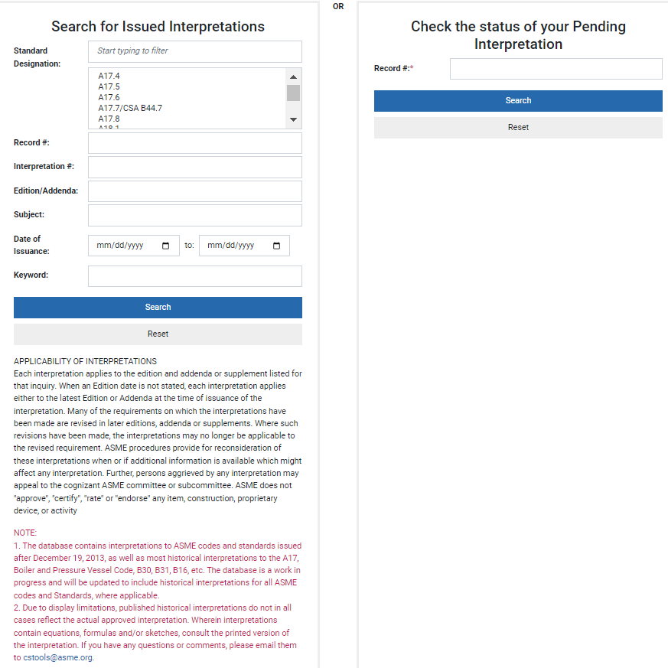
INTERPRETATION SEARCH FORM 1/3
Notes:
Here is the Interpretations Search Form. This form can be accessed through the URL on the previous page.
To search for issued interpretations, you can use any of the fields to locate interpretations
Search by standards designation - start typing the standard designator, then highlight the standard
Record #
Historical or Interpretation number
Edition
Subject
Dates of issuance range or
Keyword.
The check the Status of your pending interpretation box on the right hand side allows inquirers who are outside the committee to have access to the status of their pending interpretation. The record number was sent to the inquirer when the interpretation was submitted.

Slide 20
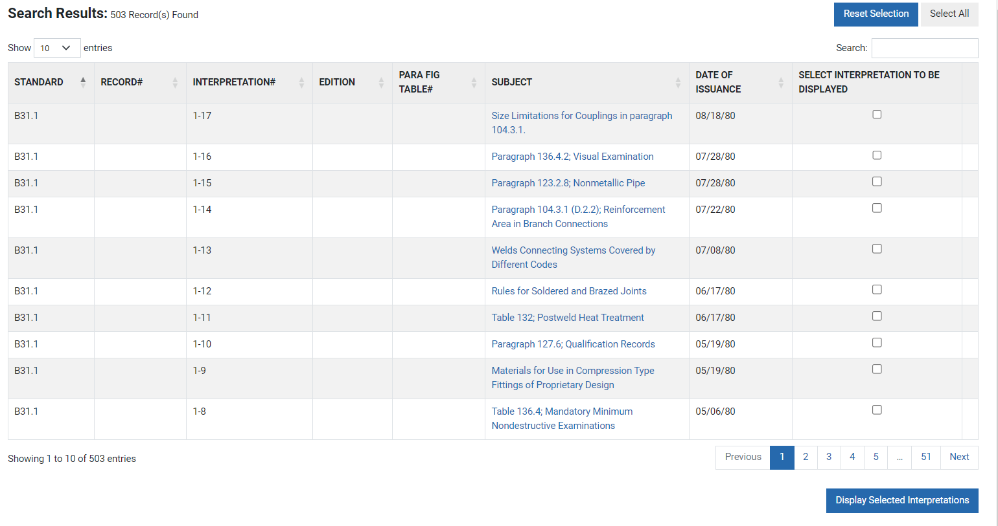
INTERPRETATION SEARCH FORM 2/3
Notes:
The resulting matches that are found will be displayed as shown above. You can click on the Subject to view the interpretation. If you wish to view multiple interpretations, click the boxes under the “Select Interpretation to be Displayed” column and click on the “display selected interpretation” button at the bottom of the page.

Slide 21
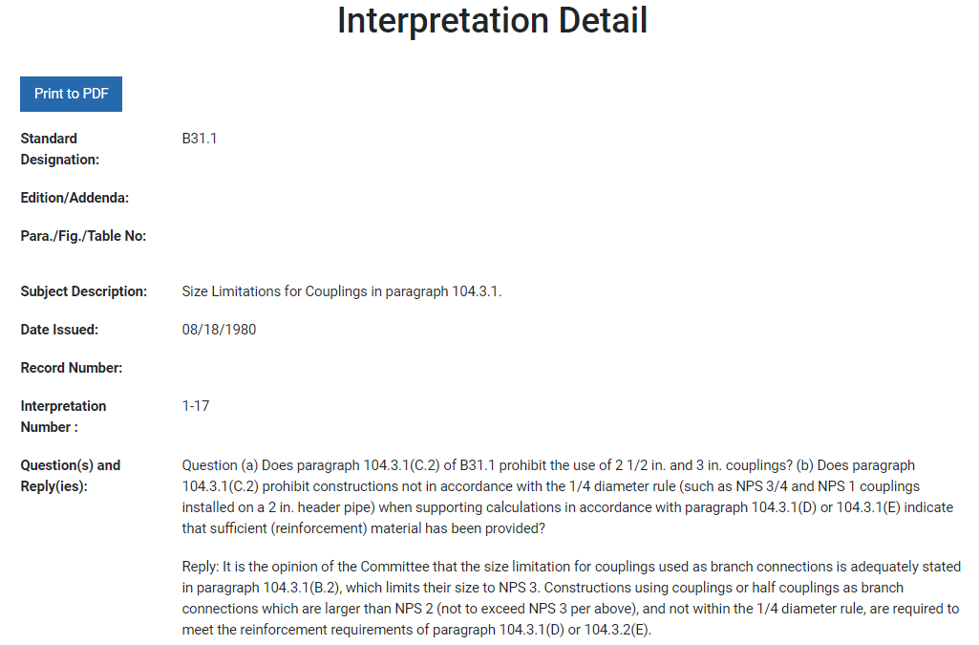
INTERPRETATION SEARCH FORM 3/3
Notes:
The interpretation details will then be displayed as shown above. To download the interpretations into a PDF file, click on the “Print to PDF” at the top of the sheet.

Slide 22
CASES
To permit early implementation of a revision based on an urgent need.
Providing alternative requirements.
To gain experience with alternative or potential additional requirements prior to incorporation directly into the standard.
To permit the use of a new material or process.
Are intended to be incorporated into the standard at a later date.
Notes:
Cases to permit early implementation of a revision based on an urgent need.
Cases can also provide alternative requirements.
Cases to gain experience with alternative or potential additional requirements prior to incorporation directly into the standard.
Cases to permit the use of a new material or process.
Cases are intended to be incorporated into the standard at a later date.
Cases can be requested directly by an inquirer or initiated by a committee.

Slide 23
CASES
Characteristics
  “Inquiry and reply” format
  Conditions of use clearly stated
  Approval by
    Consensus Committee
    Supervisory Board
    Not ANSI Approved
  Effective after Supervisory Board approval and completion of ASME public review
  Not automatically included in standards requirements
  Conformity Assessment Department must be notified
Notes:
Characteristics:
Cases are presented in an “inquiry and reply” format.
Cases clearly state the conditions under which the case may be used.
Cases require Consensus Committee approval, Supervisory Board approval, but do not require ANSI Approval.
Cases may be used as soon as when the public review process has been completed and they receive Supervisory Board approval.
Cases are not automatically included as part of the requirements.
Committees which develop requirements associated with accreditation or certification programs are responsible for notifying the Conformity Assessment Department when proposed revisions or Cases may affect those activities. This will be discussed more fully in Module B9 – ASME Conformity Assessment Programs.

Slide 24
CASES
Caution
  Should not be used by standard users unless accepted by purchasers and/or authorities in jurisdiction where component will be installed.
Notes:
Caution:
Users of a standard are cautioned against making use of Cases without having the assurance that they have been accepted by the purchaser and/or the proper authorities in the jurisdiction where the component is to be installed.

Slide 25
MODULE SUMMARY
The method of submitting an inquiry is online at… http://cstools.asme.org/Interpretation/InterpretationForm.cfm
Interpretations clarify or correct ambiguous wording in the standard.
Intent Interpretations clarify or correct conflicting and incorrect wording in the standard but results in a revision to the standard.
Notes:
In summary:
The highly preferred method of submitting an inquiry is online at…
http://cstools.asme.org/Interpretation/InterpretationForm.cfm
Interpretations clarify or correct ambiguous wording in the standard.
Intent Interpretations clarify or correct conflicting and incorrect wording in the standard but results in a revision to standard.

Slide 26
MODULE SUMMARY
Interpretations are approved by the Consensus Committee, Cognizant Subcommittee or Special Committee.
Cases are used to provide alternatives to existing requirements, or to allow early and urgent implementation of a revised requirement.
Cases require Consensus Committee and Supervisory Board approval, but do not require ANSI approval.
Notes:
Interpretations are approved by The Consensus Committee, Cognizant Subcommittee or Special Committee.
Code cases are used to provide alternatives to existing requirements, or to allow early and urgent implementation of a revised requirement.
Cases require Consensus Committee and Supervisory Board approval, but do not require ANSI approval.

Slide 27
REFERENCES
  Standards and Certification Operations Guide
  http://cstools.asme.org/csconnect/pdf/CommitteeFiles/23216.pdf
  Standards Committee Procedures, Supervisory Board Procedures and Committee Handbooks
  http://cstools.asme.org/csconnect/CommitteePages.cfm?Committee=A01000000&Action=7609
  Codes and Standards Policy 33 (Interpretations) http://cstools.asme.org/csconnect/CommitteePages.cfm?Committee=A01000000&Action=7609

