Slide 2
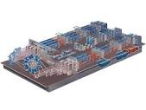
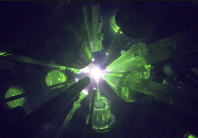
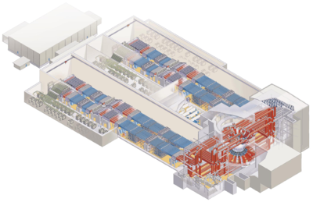
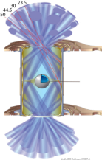
The US has pioneered the development and applications of high energy lasers motivated by Inertial fusion research

Slide 3
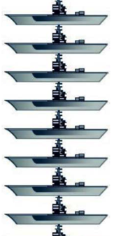
LLE and LLNL are the world leading laboratories for Inertial Confinement fusion (ICF)
Fusion requires a plasma to be heated and confined so that the product of pressure and time (Pτ) is 10 atmosphere-seconds
Inertial fusion achieves this by creating a plasma at pressures of ~100 billion atmospheres
~5 times the pressure of the center of the sun
Equal to about 12 fully loaded Nimitz Aircraft carriers balance on a fingertip!
Confinement time is then 10⁻¹⁰ seconds!
The plasma is confined by its own inertia*
* inertia: resistance to force or change
+ 4 more!
ICF is Science and technology of the “extremes”

Slide 4
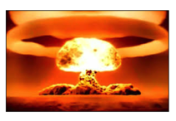
National Security
(SSP)

Slide 6
The world is not standing still-US leadership is being threatened by major investments in Europe and Asia

Slide 7
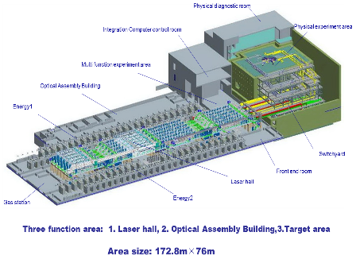
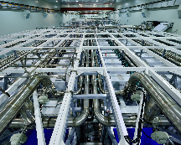
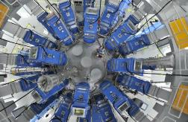
Both Russia and China are investing significantly in the area of lasers for high energy density physics
UFL-2M
• 192 beams, 2.8 MJ (1.5x NIF energy)
Construction underway
Shenguang III (180 kJ) is now operating
48 beams arranged in polar configuration
80 diagnostics
World’s second most energetic laser

Slide 10
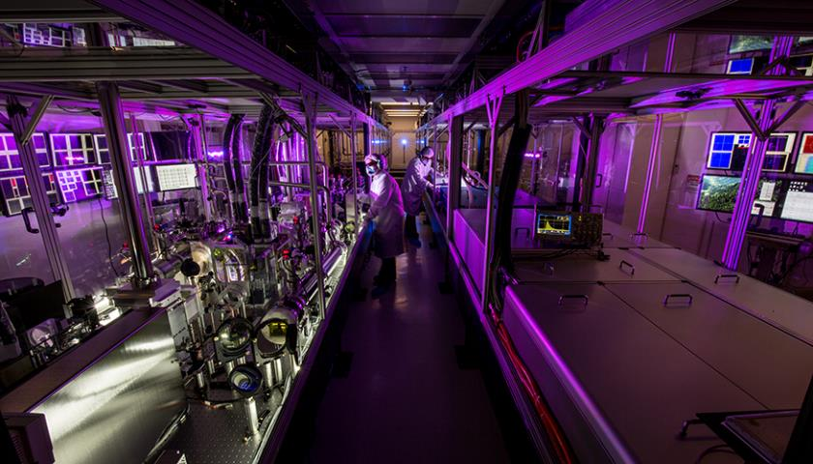
The HAPLS laser from LLNL represents State of the Art of high peak and average power lasers
National Energetics (US) and LLE are also providing lasers and technology to Europe

