Slide 1

Simulation Credibility Assessment:
Introduction to Verification, Validation, and Uncertainty Quantification (VVUQ)
Task Group on VVUQ Concepts in Engineering Education
ASME Codes & Standards | Committee on Verification, Validation, and Uncertainty Quantification
Contacts: Lydia Stanford (stanfordl@asme.org) | Daniel Papert (papertd@asme.org​)
V. 3, Draft, 2026
© 2026 by ASME Task Group on VVUQ in Engineering Education is licensed under CC BY 4.0. To view a copy of this license, visit https://creativecommons.org/licenses/by/4.0/

Slide 2
Outline
Why do we care about simulation credibility?
Structure of a simulation model and how are they are used
Simulation Verification: Quantifying numerical errors
Model Validation: Comparisons with experimental data
Predictive Capability: Simulation results plus all uncertainties
Uncertainty Quantification: Understanding uncertainty sources in simulation results
v. 3, Draft, 2026

Slide 3


Why do we care?
“All models are wrong – some are useful.” – Prof. George E. P. Box
Why is this true?
  All models rely on assumptions and approximations in the formulation of the model
  All models require input data to describe the system of interest and its surroundings, which are approximate, possibly not measurable, or not knowable in advance
  All models require numerical solution, which results in numerical errors
Infamous system failures due to erroneous modeling:
v. 3, Draft, 2026
Space Shuttle Columbia Disaster
Fukushima Nuclear Disaster

Slide 4





Structure of a simulation model
Conceptual modeling assumptions and approximations in the formulation of the model input data
Conceptual modeling assumptions and approximations in the formulation of the mathematical model
Model Input Data
$x_{i}$ $i=1,2,…,N$
$$x_{i}$$
Mathematical Model
$$f\left(x_{i}\right)$$
$$y_{j}$$
Model Output Data
$y_{j}$ $j=1,2,…,M$
Examples of model input data:
System mass
System geometry
Thermal conductivity
Young’s modulus
System initial conditions
External loading
Magnetic field intensity
Acoustic environment
Examples of mathematical models:
Nonlinear algebraic equation
Ordinary differential equation
Partial differential equation
Integral equation
Examples of model output data:
System thermal response
System deflection
Local stress and strain
Vibrational modes of a structure
Fluid lift and drag
Electrical current
Magnetic field strength
Acoustic response
v. 3, Draft, 2026

Slide 5
What do simulation models produce and how is it used?
Simulation models are used to produce information about the system of interest and its responses.
When simulation results are used in business and government:
  Simulation is referred to as a decision support tool
  The process is also referred to as simulation-informed decision making
Examples how this information can be used:
  Design of new systems or modification of existing systems
  Optimization of system design to increase performance, reliability, and safety
  Reduce development time and physical testing of the final system
  Optimize manufacturing processes
  Assess system safety in untestable environments such as accident scenarios or those that produce unacceptable risks to humans and the environment
v. 3, Draft, 2026

Slide 6
How is simulation credibility assessed?
Numerical accuracy is assessed by simulation verification:
  Simulation verification: assessment of the accuracy of the numerical solution relative to the exact solution to the mathematical model
Physics-based accuracy is assessed by model validation:
  Model validation: assessment of the accuracy of the simulation results relative to experimental measurements of system responses
Uncertainty in the simulation results is assessed by uncertainty quantification:
  Uncertainty quantification: estimation of the total uncertainty in the simulation result due to all sources of error and uncertainty in the modeling and simulation process
These assessments are collectively referred to as VVUQ.
Note: These concepts of verification and validation are distinctly different from the systems engineering concepts of V&V.
v. 3, Draft, 2026

Slide 7
Context of use of the simulation
Context of use: the relationship between the applicability and accuracy of the simulation model relative to the requirements for the intended use of the model.
Examples of issues related to the context of use:
  Are the assumptions and approximations of the formulation of the model consistent with the intended use of the model?
  Is the accuracy and uncertainty of the simulation results sufficient for the needs of the intended use of the model?
  Are the VVUQ assessment activities sufficient to insure credibility for the intended use of the model?
  Are the conditions of model validation sufficiently relevant to the actual conditions of interest for the system/subsystem under considerations?
  What are the consequences and risks involved if the simulation results are inaccurate?
v. 3, Draft, 2026

Slide 8
What is verification and why do we care?
Verification is the process that establishing the mathematical correctness of the computational model and determining the accuracy of a particular numerical solution.
Verification includes two different activities:
  Code verification is the process of determining that the mathematical model and its numerical solution is correctly implemented in the computer code. Code verification evaluates the numerical error using a known reference solution.
  Solution verification is the process of estimating the numerical accuracy of output quantities of the computational model for the application conditions of interest. Solution verification estimates the numerical error of the output quantities of interest.
v. 3, Draft, 2026

Slide 9






Verification activities
Examples of code verification activities:
Check for coding errors
Check numerical solution convergence to the exact solution as the discretization is refined (e.g., mesh size decreases)
Model Input Data
$x_{i}$ $i=1,2,…,N$
$$x_{i}$$
Mathematical Model
$$f\left(x_{i}\right)$$
Code Verification
Computational Model
$$\tilde{f}\left(x_{i}\right)$$
$${\tilde{y}}_{j}$$
Model Output Data
${\tilde{y}}_{j}$ $j=1,2,…,M$
Aspects of numerical implementation in computational models:
Discretization of equations in space and time
Algorithms (linearization, iterative methods, coupling,…)
Computer programming (coding)
Discretization of domain (meshing, time stepping)
Solution Verification
Examples of numerical errors assessed in solution verification:
Round-off errors
Iterative errors
Discretization errors
Statistical sampling errors
v. 3, Draft, 2026

Slide 10
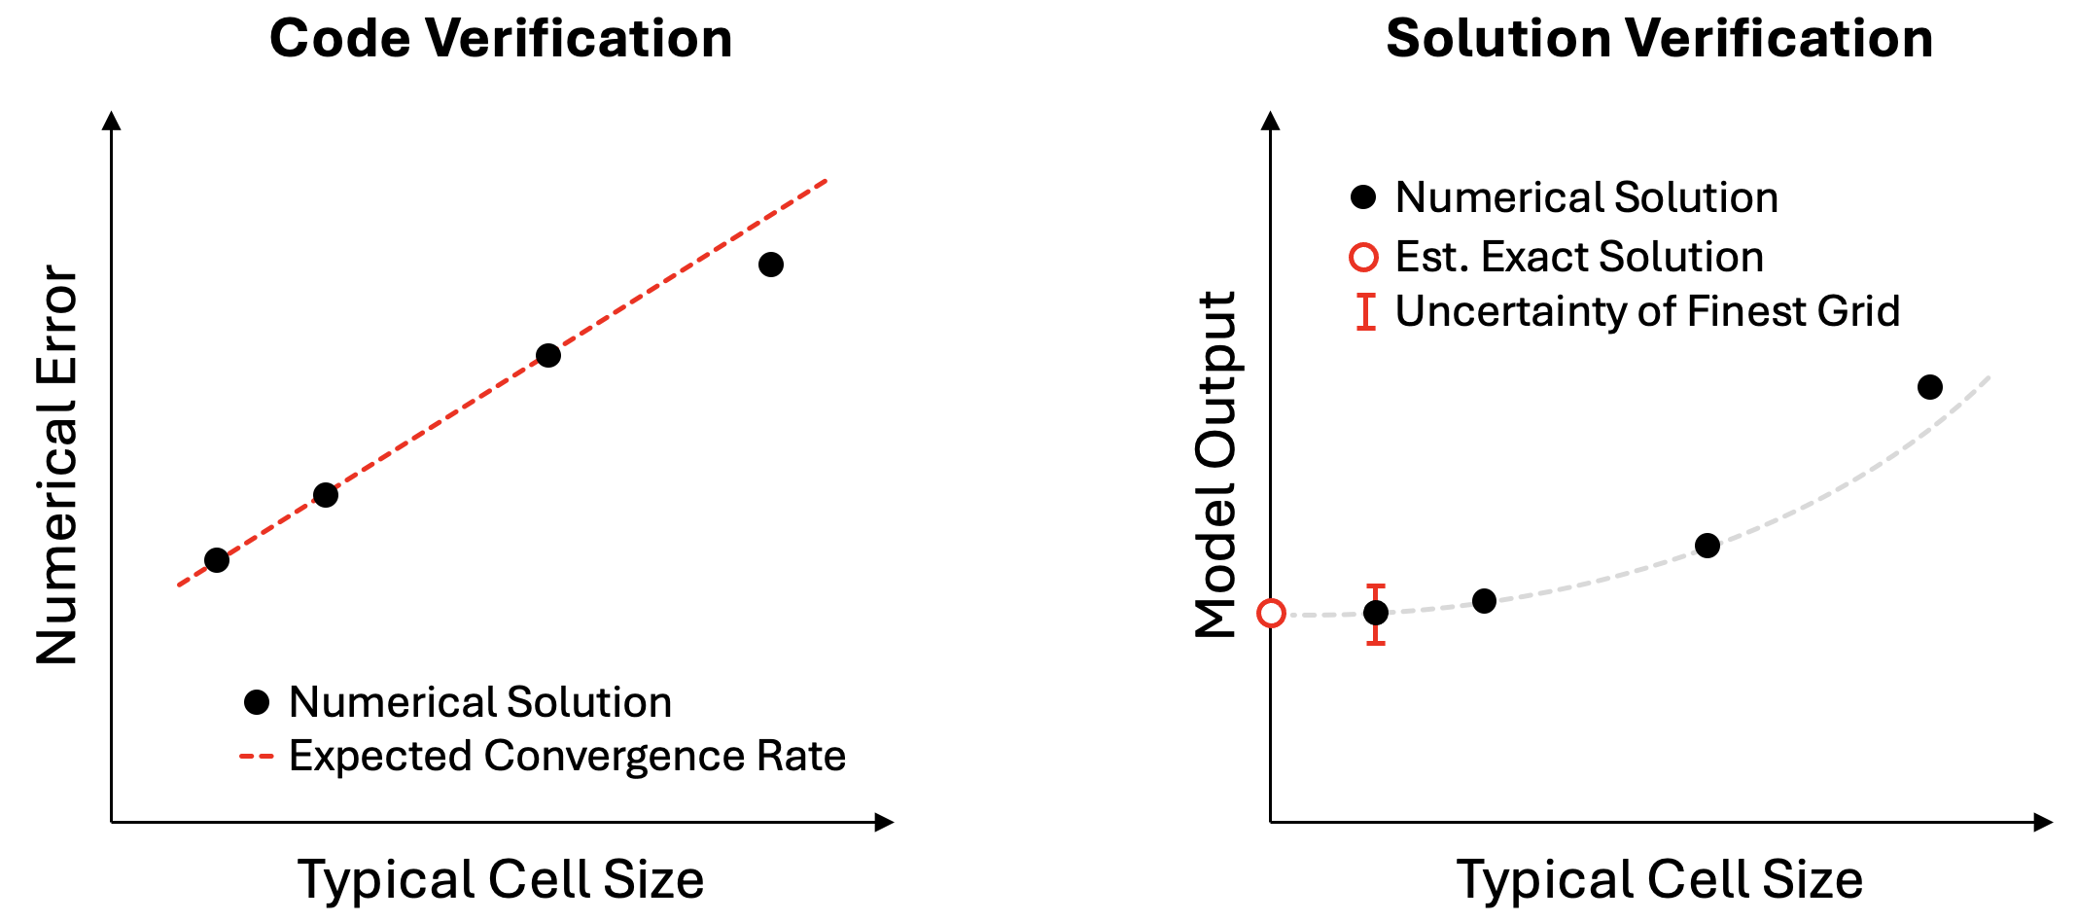
How is it code verification performed?
Code verification requires a known solution to a problem that is solved with the same mathematical model. For example, a problem that uses the same terms for the transport of mass, momentum, and energy as the application of interest.
Known reference solutions can come from:
  Classical analytical solutions
  Manufactured solutions
  Highly accurate numerical solutions
Numerical solutions are computed and the error is evaluated on a series of refined grids and time steps to determine the numerical order of accuracy.
Code verification is a software testing procedure.
v. 3, Draft, 2026

Slide 11
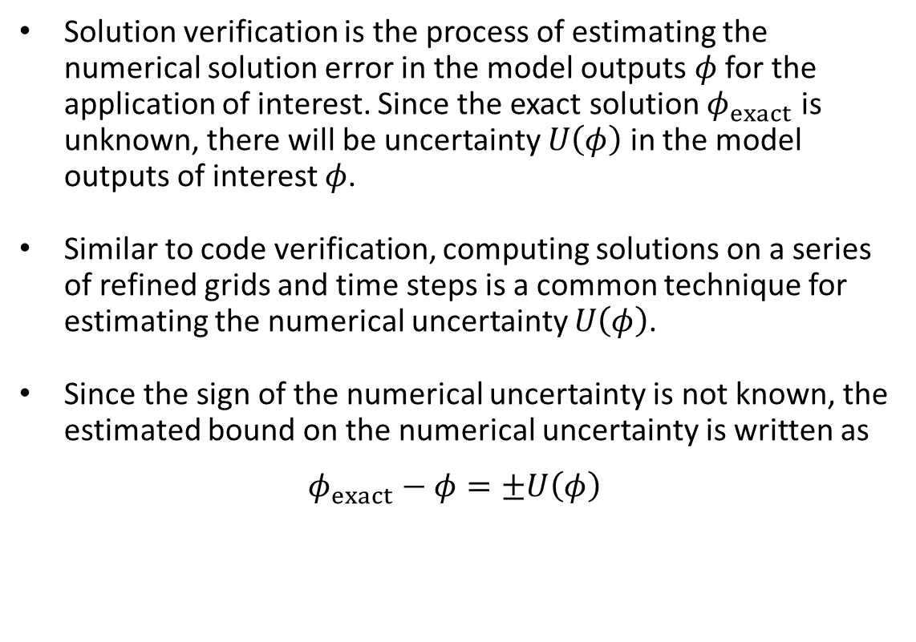
How is it solution verification performed?
Solution verification is the process of estimating the numerical solution error in the model outputs $φ$ for the application of interest. Since the exact solution $φ_{exact}$ is unknown, there will be uncertainty $U\left(φ\right)$ in the model outputs of interest $φ$.
Similar to code verification, computing solutions on a series of refined grids and time steps is a common technique for estimating the numerical uncertainty $U\left(φ\right)$.
Since the sign of the numerical uncertainty is not known, the estimated bound on the numerical uncertainty is written as
$$φ_{exact}−φ=±U\left(φ\right)$$
v. 3, Draft, 2026

Slide 12







What is model validation and why do we care?
Computational modeling and simulation are used to aid the decision-making process
  e.g., Predicting deformation of a structure: an inaccurate model could lead to poor decisions, potentially resulting in excessive deformation or even failure of a bridge or building.
Validation compares the simulation model results to real-world observations (data) to ensure it captures essential features (physical phenomena) of the real system.
Validation data should reflect the conditions of the intended use of the model.
  e.g., Assessing the predicted deformation of a structure against measured deformation under realistic or maximum loading conditions.
Aspects of validation:
Validation metrics
Metric threshold (decision-making)
Validation experiments (design of experiments)
Model output and experimental uncertainty
Intended use and extrapolation
Model Input Data
$x_{i}$ $i=1,2,…,N$
$$x_{i}$$
Mathematical Model
$$f\left(x_{i}\right)$$
Code Verification
Computational Model
$$\tilde{f}\left(x_{i}\right)$$
$${\tilde{y}}_{j}$$
Model Output Data
${\tilde{y}}_{j}$ $j=1,2,…,M$
Experimental Data
$y_{j}^{d}$ $j=1,2,…,M$
Solution Verification
Model Validation
v. 3, Draft, 2026

Slide 13
How are validation experiments different from other experiments?
Traditional experiments/tests are conducted to:
  Improve physical understanding of the physical processes occurring
  Calibrate/update model input parameters
  Assess or certify system/subsystem performance or safety
Model validation experiments are conducted for the primary purpose of assessing the ability of the simulation model to predict the system responses for the experiment that is conducted.
Validation experiments can be conducted on the actual system of interest, but more commonly it is:
  A subsystem, assembly, or component of the actual system of interest
  The experimental conditions are not fully representative of the actual operating conditions of the system
Other important features of validation experiments:
  Experimental measurement uncertainty should be estimated in both the system response quantities of interest and the input quantities that are used the simulation model
  Quantitative methods should be used to assess the agreement between simulation and experimental results
  Blind model predictions of the validation experiment are the most informative of predictive capability
v. 3, Draft, 2026

Slide 14
What is model prediction?
Prediction involves producing model outputs for which corresponding measured data is not available.
Validation domain: A model is validated against experimental results at a specific set of input conditions (‘validation points’) that form the validation domain.
Intended use domain: Predictions in the intended use domain of the model input space may be interpolative or extrapolative with respect to the validation domain.
Model Input Settings for Prediction
Intended use domain
Model Input 2
Validation point
Validation domain
Model Input 1
Image credit: adapted from V&V 10
v. 3, Draft, 2026

Slide 15
What is predictive capability of a model?
Predictive capability is producing a simulation result, including all sources of uncertainty, at conditions where no experimental measurements are available.
Predictive capability is informed by:
  Quantitative validation assessment at conditions relevant to the prediction conditions of interest
  The similarity of the conditions at the prediction conditions to the model validation conditions
  The estimated magnitude of all the numerical solution uncertainties at the prediction conditions of interest
  The effect of the model input uncertainties at the prediction conditions of interest
  The uncertainty due to the model formulation itself, i.e., model form uncertainty
A simulation model’s adequacy for intended use involves diverse requirements such as:
  Requirements for model accuracy plus uncertainty at the prediction conditions of interest
  Economic, safety, and liability risks if the simulation model is potentially inaccurate
  Personnel, computer, and software costs to produce the simulation results
  Experience level required of the personnel to produce credible simulation results
v. 3, Draft, 2026

Slide 16
What is uncertainty quantification and why do we care?
Uncertainty Quantification (UQ) is the process of using statistical models to provide an estimate of uncertainty in the experimental and simulation results.
Uncertainty Quantification has three basic steps:
  Characterize Uncertainties: Identify all relevant uncertainties and characterize the uncertainties as much as is possible
  Propagate Uncertainties: Perform model evaluations to estimate the impact of model input uncertainties on the system response quantities of interest (QoIs)
  Interpret Results: Compute and explain the sources and impact of the uncertainties to the simulation customer
Uncertainty quantification is important because it informs the customer of the simulation results how the uncertainties impact the simulation results.
v. 3, Draft, 2026

Slide 17







Characterize uncertainties
Identify most import sources of uncertainties including inputs and parameters
Estimate the uncertainty in these values. Methods include calibration, data, subject matter expertise, first-principles, etc.
Parameters
Model Input Data
$x_{i}$ $i=1,2,…,N$
$$x_{i}$$
Mathematical Model
$$f\left(x_{i}\right)$$
Code Verification
Inputs
Computational Model
$$\tilde{f}\left(x_{i}\right)$$
$${\tilde{y}}_{j}$$
Model Output Data
${\tilde{y}}_{j}$ $j=1,2,…,M$
Experimental Data
$y_{j}^{d}$ $j=1,2,…,M$
Numerical
Solution Verification
Model Validation
Measurement uncertainty
Examples of model input uncertainty:
Boundary/Initial conditions
Material properties
Geometry
Measurement uncertainty (inputs)
Uncertainty Quantification
Examples of model uncertainty:
Model form (physical assumptions/simplifications)
Parameters (calibration/tuning)
Numerical errors (solution errors, surrogate model errors, statistical sampling errors)
Examples of measurement uncertainty:
Limited number of measurements
Statistical sampling errors
Measurement bias
Data reduction
v. 3, Draft, 2026

Slide 18





Propagate uncertainties and interpret results
Take samples of uncertainty sources to create an ensemble of model inputs
Run each set of inputs through the model
Create an ensemble of model outputs
Samples from uncertainties
Inputs
Parameters
Numerical
Model Input Data
$x_{i}$ $i=1,2,…,N$
Mathematical Model
$$f\left(x_{i}\right)$$
Uncertainty Quantification
Model Input Data
$x_{i}$ $i=1,2,…,N$
Model Output Data
${\tilde{y}}_{j}$ $j=1,2,…,M$
Model Input Data
$x_{i}$ $i=1,2,…,N$
Model Output Data
${\tilde{y}}_{j}$ $j=1,2,…,M$
Model Input Data
$x_{i}$ $i=1,2,…,N$
Model Output Data
${\tilde{y}}_{j}$ $j=1,2,…,M$
Model Input Data
$x_{i}$ $i=1,2,…,N$
Model Output Data
${\tilde{y}}_{j}$ $j=1,2,…,M$
Computational Model
$$\tilde{f}\left(x_{i}\right)$$
Model Output Data
${\tilde{y}}_{j}$ $j=1,2,…,M$
Results can be interpreted in many ways including:
Mean and standard deviation
Median and other percentiles
Histogram or probability distribution
v. 3, Draft, 2026

Slide 19
Rank the impact of uncertain inputs using sensitivity analysis
Closely related to UQ is Sensitivity Analysis where the importance of the model parameters are identified and potentially ranked.
Various approaches:
Local Sensitivity Analysis: Estimate sensitivity with small perturbations to the nominal model parameters
Global Sensitivity Analysis: Evaluate the sensitivity over the full range of the parameters
Sensitivity Analysis can be used to:
Select optimal design parameters to achieve system performance requirements
Identify the largest contributors to uncertainty in system responses
v. 3, Draft, 2026

Slide 20
References
AIAA (2024), ”Standard for Code Verification in Computational Fluid Dynamics." American Institute of Aeronautics and Astronautics, AIAA S-141-2024, Reston, VA.
ASME (2009), "Standard for Verification and Validation in Computational Fluid Dynamics and Heat Transfer." American Society of Mechanical Engineers, ASME Standard V&V 20-2009(R2021), New York, NY.
ASME (2018), "Assessing Credibility of Computational Modeling Through Verification and Validation: Application to Medical Devices," American Society of Mechanical Engineers, New York, NY, ASME V&V 40-2018, New York, NY.
ASME (2019), "Standard for Verification and Validation in Computational Solid Mechanics." American Society of Mechanical Engineers, ASME Standard V&V 10-2019, New York, NY.
ASME (2021), "The Role of Uncertainty Quantification in Verification and Validation of Computational Solid Mechanics Models," American Society of Mechanical Engineers, ASME VVUQ 10.2-2021, New York, NY.
ASME (2022), "Verification, Validation, and Uncertainty Quantification Terminology in Computational Modeling and Simulation," American Society of Mechanical Engineers, ASME VVUQ 1-2022, New York, NY.
McClarren, R. G. (2018), Uncertainty Quantification and Predictive Computational Science, Springer, Cham, Switzerland.
NA (2024), "Foundational Research Gaps and Future Directions for Digital Twins." National Academies of Sciences, Engineering and Medicine, DOI 10.17226/26894, Washington, DC.
v. 3, Draft, 2026

Slide 21
References (continued)
NaRC (2012), "Assessing the Reliability of Complex Models: Mathematical and Statistical Foundations of Verification, Validation, and Uncertainty Quantification." National Research Council of the National Academies, ISBN-13: 978-0-309-25634-6, Washington, DC.
NASA (2010), "NASA Risk-Informed Decision Making Handbook." National Aeronautics and Space Administration, NASA/SP-2010-576, Washington, DC.
NASA (2016), "Standard for Models and Simulations." National Aeronautics and Space Administration, NASA-STD-7009A, Washington, DC.
Oberkampf, W. L. and C. J. Roy (2025), Verification, Validation and Uncertainty Quantification in Scientific Computing, 2nd edition, Cambridge University Press, UK.
Roache, P. J. (2009), Fundamentals of Verification and Validation, Hermosa Publishers, Socorro, New Mexico.
Smith, R. C. (2024), Uncertainty Quantification: Theory, Implementation, and Applications, 2nd edition, Society for Industrial and Applied Mathematics, Philadelphia, PA.
Saltelli, A., Ratto, M., Adres, T., Campolongo, F., Cariboni, J., Gatelli, D., Saisana, M., Taratola, S., (2008), Global Sensitivity Analysis: The Primer, Wiley, England
Sullivan, T. J. (2015), Introduction to Uncertainty Quantification, Springer, Heidelberg.
TMS (2019), Verification & Validation of Computational Models Associated with the Mechanics of Materials, The Minerals, Metals & Materials Society, ISBN 978-0-578-45369-9, Pittsburgh, PA.
v. 3, Draft, 2026

