Slide 1

Introduction to VVUQ | Part 2
Verification
Task Group on VVUQ Concepts in Engineering Education
ASME Codes & Standards | Committee on Verification, Validation, and Uncertainty Quantification
Contacts: Lydia Stanford (stanfordl@asme.org)​ | Daniel Papert (papertd@asme.org​)
V. 3, Draft, 2026
© 2026 by ASME Task Group on VVUQ in Engineering Education is licensed under CC BY 4.0. To view a copy of this license, visit https://creativecommons.org/licenses/by/4.0/

Slide 2
Outline
What is verification, and why do we care?
Verification activities: code and solution verification
How is code verification performed?
How is solution verification performed?
v. 3, Draft, 2026

Slide 3
What is verification and why do we care?
Verification is the process that establishing the mathematical correctness of the computational model and determining the accuracy of a particular numerical solution.
Verification includes two different activities:
  Code verification is the process of determining that the mathematical model and its numerical solution is correctly implemented in the computer code. Code verification evaluates the numerical error using a known reference solution.
  Solution verification is the process of estimating the numerical accuracy of output quantities of the computational model for the application conditions of interest. Solution verification estimates the numerical error of the output quantities of interest.
v. 3, Draft, 2026

Slide 4






Verification activities
Examples of code verification activities:
Check for coding errors
Check numerical solution convergence to the exact solution as the discretization is refined (e.g., mesh size decreases)
Model Input Data
$x_{i}$ $i=1,2,…,N$
$$x_{i}$$
Mathematical Model
$$f\left(x_{i}\right)$$
Code Verification
Computational Model
$$\tilde{f}\left(x_{i}\right)$$
$${\tilde{y}}_{j}$$
Model Output Data
${\tilde{y}}_{j}$ $j=1,2,…,M$
Aspects of numerical implementation in computational models:
Discretization of equations in space and time
Algorithms (linearization, iterative methods, coupling,…)
Computer programming (coding)
Discretization of domain (meshing, time stepping)
Solution Verification
Examples of numerical errors assessed in solution verification:
Round-off errors
Iterative errors
Discretization errors
Statistical sampling errors
v. 3, Draft, 2026

Slide 5
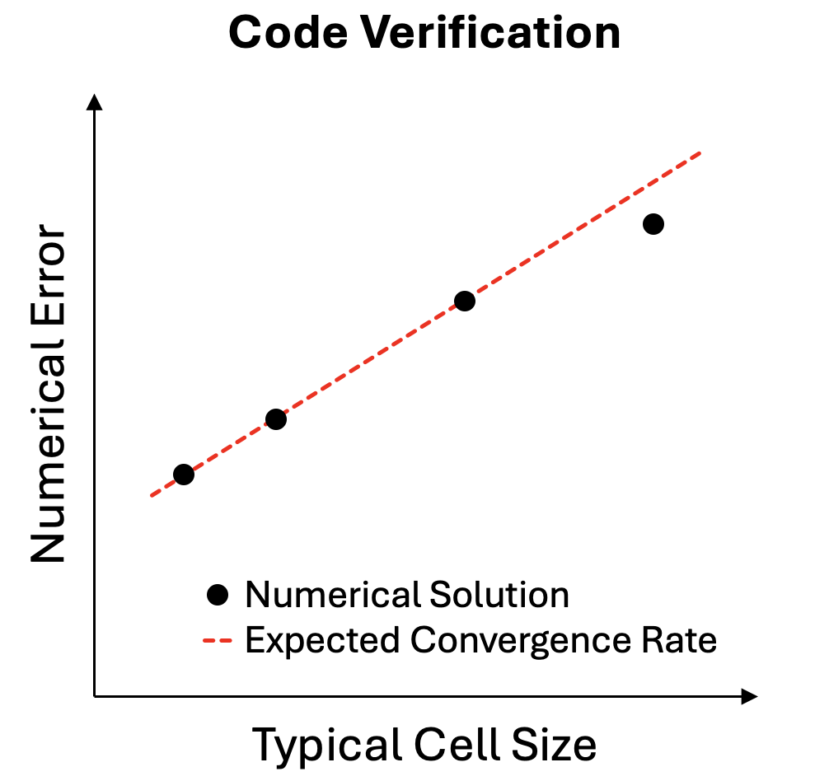
How is it code verification performed?
Code verification requires a known solution to a problem that is solved with the same mathematical model. For example, a problem that uses the same terms for the transport of mass, momentum, and energy as the application of interest.
Known reference solutions can come from:
  Classical analytical solutions
  Manufactured solutions
  Highly accurate numerical solutions
Numerical solutions are computed and the error is evaluated on a series of refined grids and time steps to determine the numerical order of accuracy.
Code verification is a software testing procedure.
v. 3, Draft, 2026

Slide 6
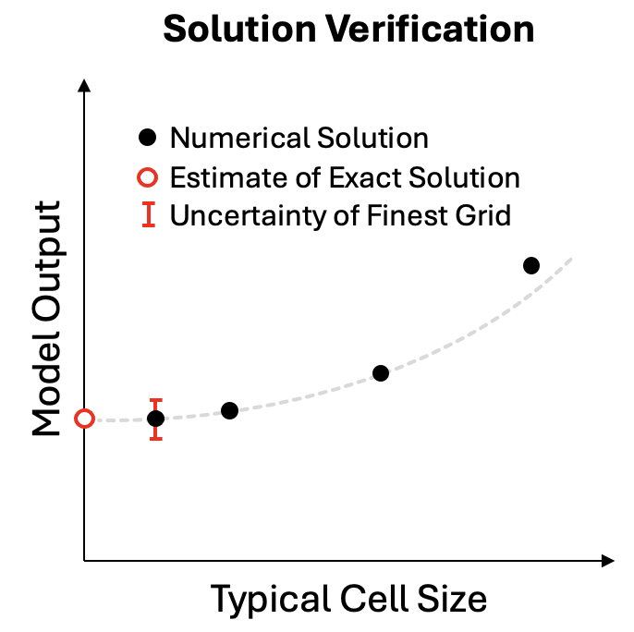
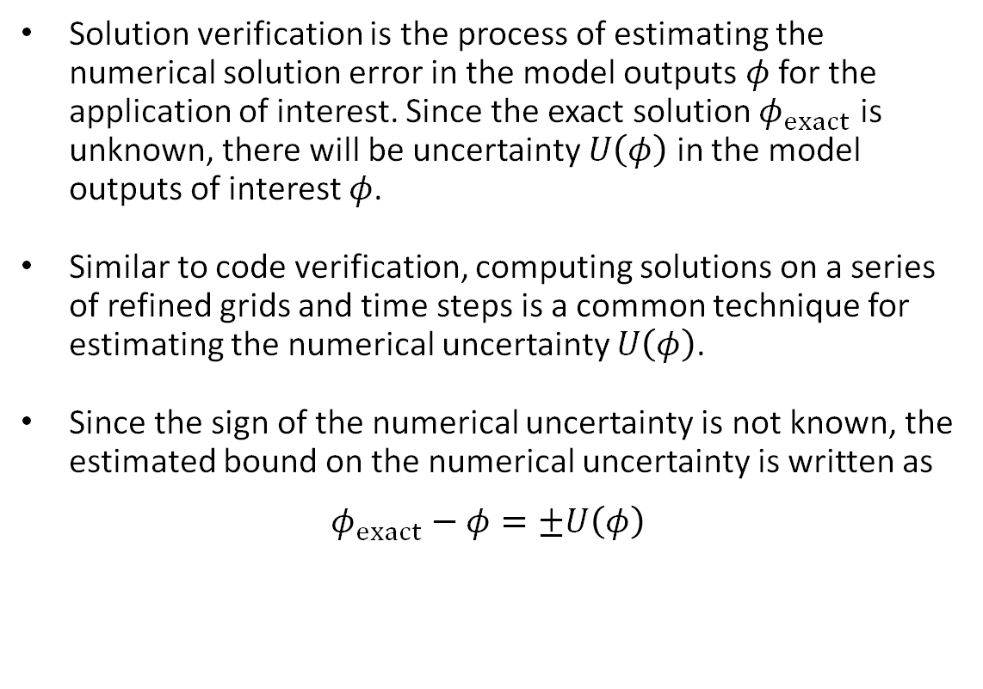
How is it solution verification performed?
Solution verification is the process of estimating the numerical solution error in the model outputs $φ$ for the application of interest. Since the exact solution $φ_{exact}$ is unknown, there will be uncertainty $U\left(φ\right)$ in the model outputs of interest $φ$.
Similar to code verification, computing solutions on a series of refined grids and time steps is a common technique for estimating the numerical uncertainty $U\left(φ\right)$.
Since the sign of the numerical uncertainty is not known, the estimated bound on the numerical uncertainty is written as
$$φ_{exact}−φ=±U\left(φ\right)$$
v. 3, Draft, 2026

Slide 7
References
ASME (2022), "Verification, Validation, and Uncertainty Quantification Terminology in Computational Modeling and Simulation," American Society of Mechanical Engineers, ASME VVUQ 1-2022, New York, NY.
ASME (2019), "Standard for Verification and Validation in Computational Solid Mechanics." American Society of Mechanical Engineers, ASME Standard V&V 10-2019, New York, NY.
ASME (2009), "Standard for Verification and Validation in Computational Fluid Dynamics and Heat Transfer." American Society of Mechanical Engineers, ASME Standard V&V 20-2009(R2021), New York, NY.
Oberkampf, W. L. and C. J. Roy (2010), Verification and Validation in Scientific Computing, Cambridge University Press, UK.
Roache, P. J. (2009), Fundamentals of Verification and Validation, Hermosa Publishers, Socorro, New Mexico.
v. 3, Draft, 2026

