Slide 1

Introduction to VVUQ | Part 1
Simulation Credibility Assessment
Task Group on VVUQ Concepts in Engineering Education
ASME Codes & Standards | Committee on Verification, Validation, and Uncertainty Quantification
Contacts: Lydia Stanford (stanfordl@asme.org) | Daniel Papert (papertd@asme.org​)
V. 3, Draft, 2026
© 2026 by ASME Task Group on VVUQ in Engineering Education is licensed under CC BY 4.0. To view a copy of this license, visit https://creativecommons.org/licenses/by/4.0/

Slide 2
Outline
Why do we care?
Structure of a simulation model
How is a simulation model assessed?
How is simulation credibility assessed?
Context of use of the simulation
v. 3, Draft, 2026

Slide 3
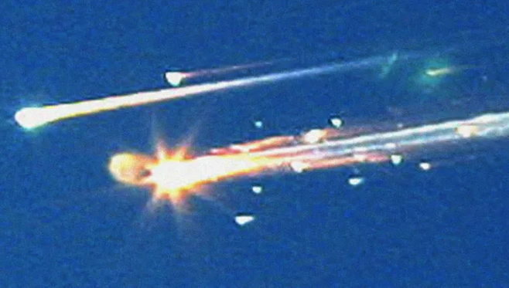
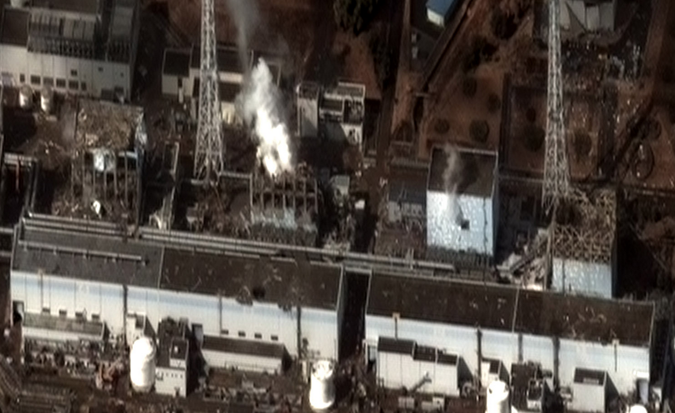
Why do we care?
“All models are wrong – some are useful.” – Prof. George E. P. Box
Why is this true?
  All models rely on assumptions and approximations in the formulation of the model
  All models require input data to describe the system of interest and its surroundings, which are approximate or possibly not measurable
  All models require numerical solution, which results in numerical errors
Infamous system failures due to erroneous modeling:
v. 3, Draft, 2026
Space Shuttle Columbia Disaster
Fukushima Nuclear Disaster

Slide 4





Structure of a simulation model
Conceptual modeling assumptions and approximations in the formulation of the model input data
Conceptual modeling assumptions and approximations in the formulation of the mathematical model
Model Input Data
$x_{i}$ $i=1,2,…,N$
$$x_{i}$$
Mathematical Model
$$f\left(x_{i}\right)$$
$$y_{j}$$
Model Output Data
$y_{j}$ $j=1,2,…,M$
Examples of model input data:
System mass
System geometry
Thermal conductivity
Young’s modulus
System initial conditions
External loading
Magnetic field intensity
Acoustic environment
Examples of mathematical models:
Nonlinear algebraic equation
Ordinary differential equation
Partial differential equation
Integral equation
Examples of model output data:
System thermal response
System deflection
Local stress and strain
Vibrational modes of a structure
Fluid lift and drag
Electrical current
Magnetic field strength
Acoustic response
v. 3, Draft, 2026

Slide 5
What do simulation models produce and how is it used?
Simulation models are used to produce information about the system of interest and its responses.
When simulation results are used in business and government:
  Simulation is referred to as a decision support tool
  The process is also referred to as simulation-informed decision making
Examples how this information can be used:
  Design of new systems or modification of existing systems
  Optimization of system design to increase performance, reliability, and safety
  Reduce development time and physical testing of the final system
  Optimize manufacturing processes
  Assess system safety in untestable environments such as accident scenarios or those that produce unacceptable risks to humans and the environment
v. 3, Draft, 2026

Slide 6
How is simulation credibility assessed?
Numerical accuracy is assessed by simulation verification:
  Simulation verification: assessment of the accuracy of the numerical solution relative to the exact solution to the mathematical model
Physics-based accuracy is assessed by model validation:
  Model validation: assessment of the accuracy of the simulation results relative to experimental measurements of system responses
Uncertainty in the simulation results is assessed by uncertainty quantification:
  Uncertainty quantification: estimation of the total uncertainty in the simulation result due to all sources of error and uncertainty in the modeling and simulation process
These assessments are collectively referred to as VVUQ.
Note: These concepts of verification and validation are distinctly different from the systems engineering concepts of V&V.
v. 3, Draft, 2026

Slide 7
Context of use of the simulation
Context of use: the relationship between the applicability and accuracy of the simulation model relative to the requirements for the intended use of the model.
Examples of issues related to the context of use:
  Are the assumptions and approximations of the formulation of the model consistent with the intended use of the model?
  Is the accuracy and uncertainty of the simulation results sufficient for the needs of the intended use of the model?
  Are the VVUQ assessment activities sufficient to insure credibility for the intended use of the model?
  Are the conditions of model validation sufficiently relevant to the actual conditions of interest for the system/subsystem under considerations?
  What are the consequences and risks involved if the simulation results are inaccurate?
v. 3, Draft, 2026

Slide 8
References
AIAA (2021), "Recommended Practice: Code Verification in Computational Fluid Dynamics." American Institute of Aeronautics and Astronautics, AIAA R-141-2021, Reston, VA.
ASME (2018), "Assessing Credibility of Computational Modeling Through Verification and Validation: Application to Medical Devices," American Society of Mechanical Engineers, New York, NY, ASME V&V 40-2018, New York, NY.
ASME (2019), "Standard for Verification and Validation in Computational Solid Mechanics." American Society of Mechanical Engineers, ASME Standard V&V 10-2019, New York, NY.
ASME (2021), "The Role of Uncertainty Quantification in Verification and Validation of Computational Solid Mechanics Models," American Society of Mechanical Engineers, ASME VVUQ 10.2-2021, New York, NY.
ASME (2022), "Verification, Validation, and Uncertainty Quantification Terminology in Computational Modeling and Simulation," American Society of Mechanical Engineers, ASME VVUQ 1-2022, New York, NY.
McClarren, R. G. (2018), Uncertainty Quantification and Predictive Computational Science, Springer, Cham, Switzerland.
NaRC (2012), "Assessing the Reliability of Complex Models: Mathematical and Statistical Foundations of Verification, Validation, and Uncertainty Quantification." National Research Council of the National Academies, ISBN-13: 978-0-309-25634-6, Washington, DC.
NASA (2016), "Standard for Models and Simulations." National Aeronautics and Space Administration, NASA-STD-7009A, Washington, DC.
Oberkampf, W. L. and C. J. Roy (2025), Verification, Validation, and Uncertainty Quantification in Scientific Computing, 2nd edition, Cambridge University Press, UK.
Roache, P. J. (2009), Fundamentals of Verification and Validation, Hermosa Publishers, Socorro, New Mexico.
TMS (2019), Verification & Validation of Computational Models Associated with the Mechanics of Materials, The Minerals, Metals & Materials Society, ISBN 978-0-578-45369-9, Pittsburgh, PA.
v. 3, Draft, 2026

